Slide 1
Final Project: Lung Segmentation by Nguyễn Minh Phát Supervisors: Dr. Ngô Quốc Hưng, Lê Nguyễn Thanh Huy
VTCA-COTAI AI Foundations for Practitioners

Slide 2
Outline
Introduction
TEFPA framework
Conclusion
Further studies
References

Slide 3
Introduction
Lung segmentation is image segmentation in computer vision which using deep neural network (DNN) to train model.
The project task is to segment lung from the X-ray image.
Literally, the problem is to label each pixel of the original image (Background vs. Masked object).

Slide 4
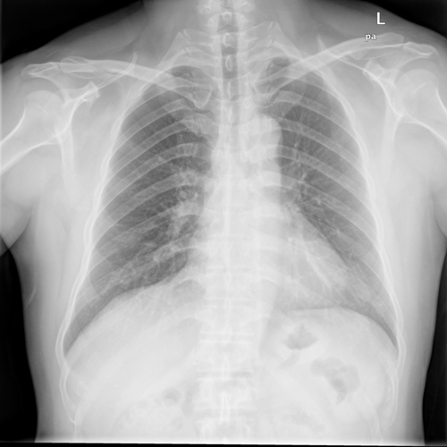
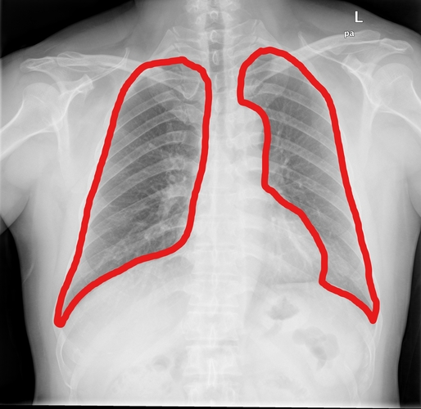

Introduction
Input Task Output

Slide 5
TEFPA framework
Task: labeling pixel from original image (background and object)
Experience: dataset with X-ray images and corresponding masked images.
Function space: U-net model.
Performance measure: Intersection over Union metric.
Algorithm: optimizer Adam

Slide 6
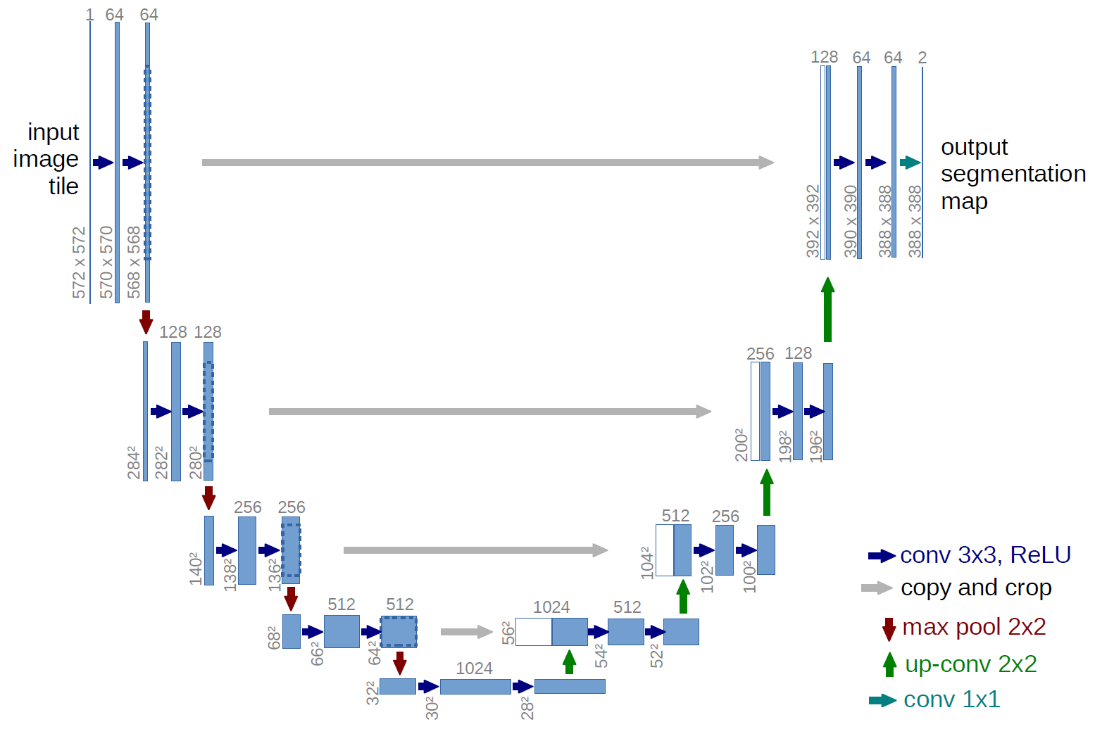
U-net model by Olaf Ronnerberger et al
Encoding
Decoding

Slide 7
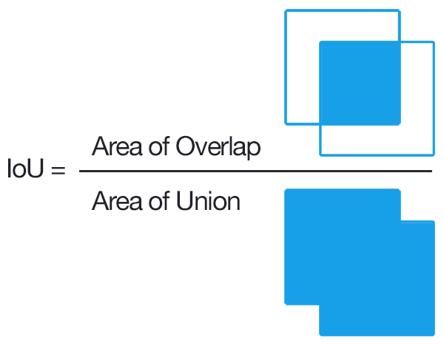
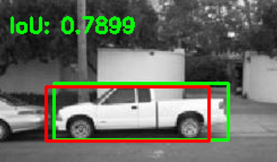
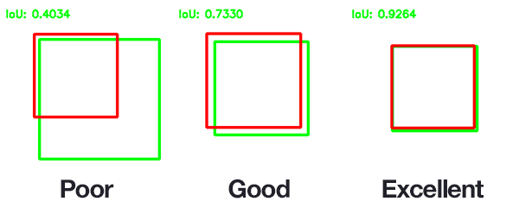
Intersection over Union (IoU):

Slide 8
Conclusion
U-net model gets high precision but slow training time (over 30 millions parameter).
Using in processing medical and biological images.
Not suitable for training real-time data (autonomous vehicles)

Slide 9
Further studies
Focusing on Computer vision section.
Trying to solve problems which involve in images or videos.
Practicing more projects in computer vision.

Slide 10
Reference
U-net model: https://github.com/zhixuhao/unet https://github.com/bnsreenu/python_for_microscopists
Lung dataset: https://www.kaggle.com/nikhilpandey360/chest-xray-masks-and-labels
TEFPA framework by Dr.Ngô Quốc Hưng (hung.ngo@cot.ai)

Slide 11
Thank you for your attention

